Slide 1
Campus Traffic Count
Team - DC20036
Shaoli Qian, Yannan Liu, Wenshan Cao
Notes:
Photo by Ren Ran on Unsplash

Slide 2
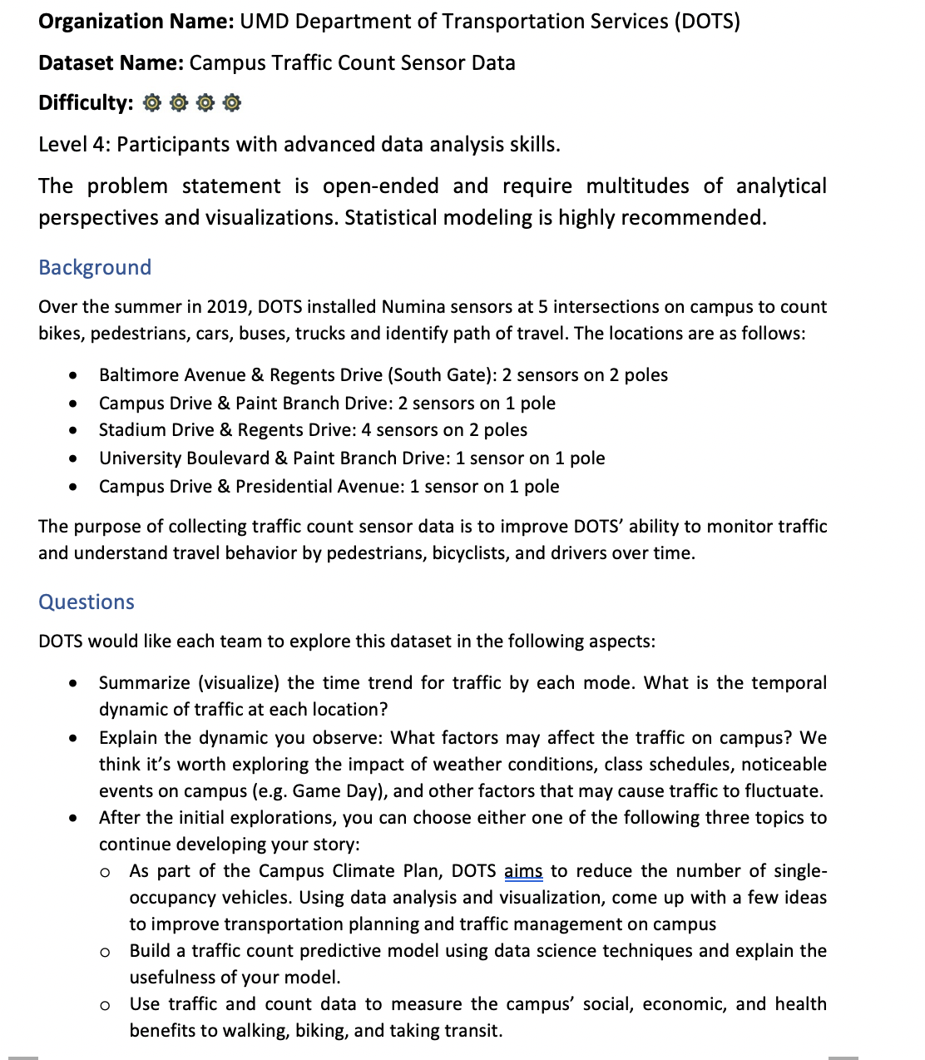
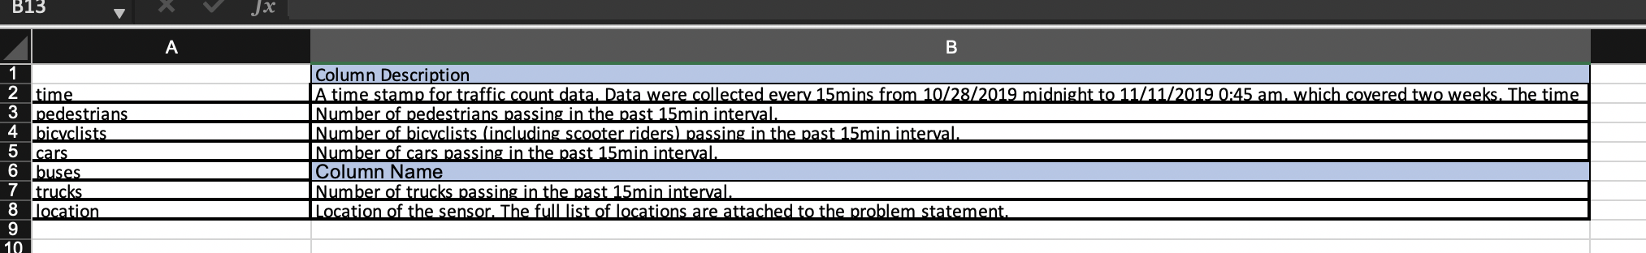
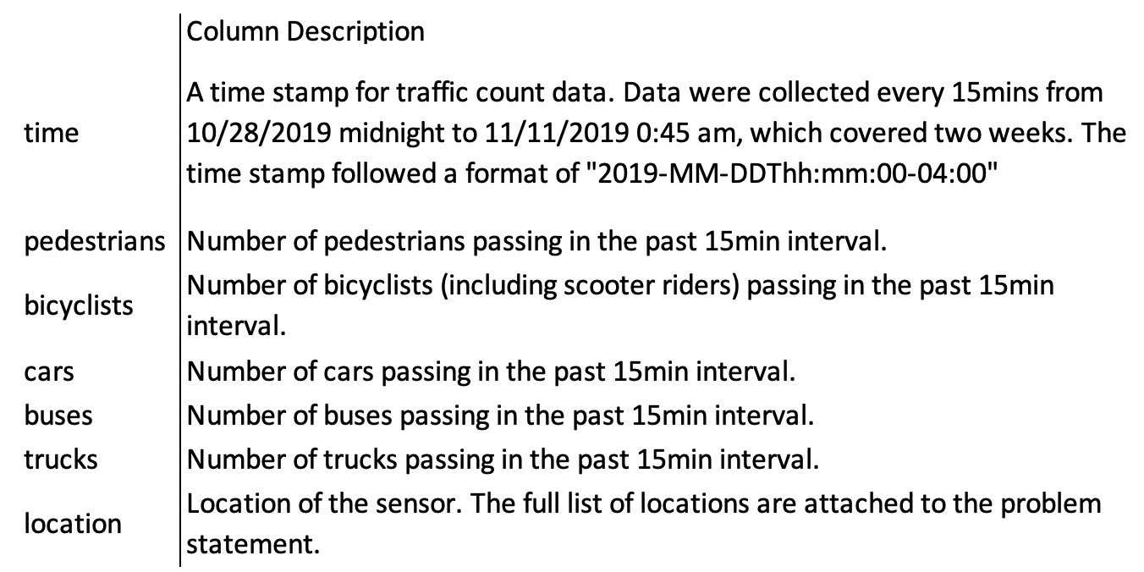
Our Goals
A good practice in data analysis;
Sustainable output for future use.
Problem Statement
Data Dictionary

Slide 3
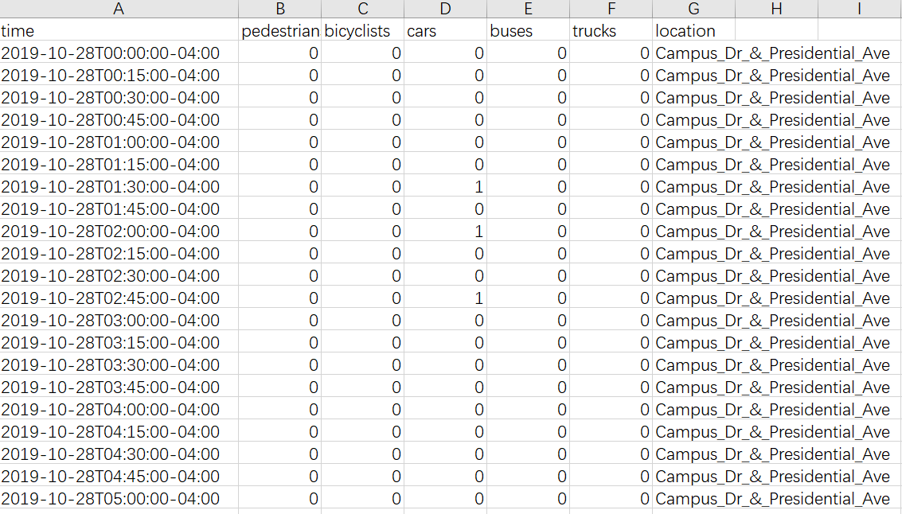
Observe
Raw dataset
2 week
5 modes
10 sensors

Slide 4
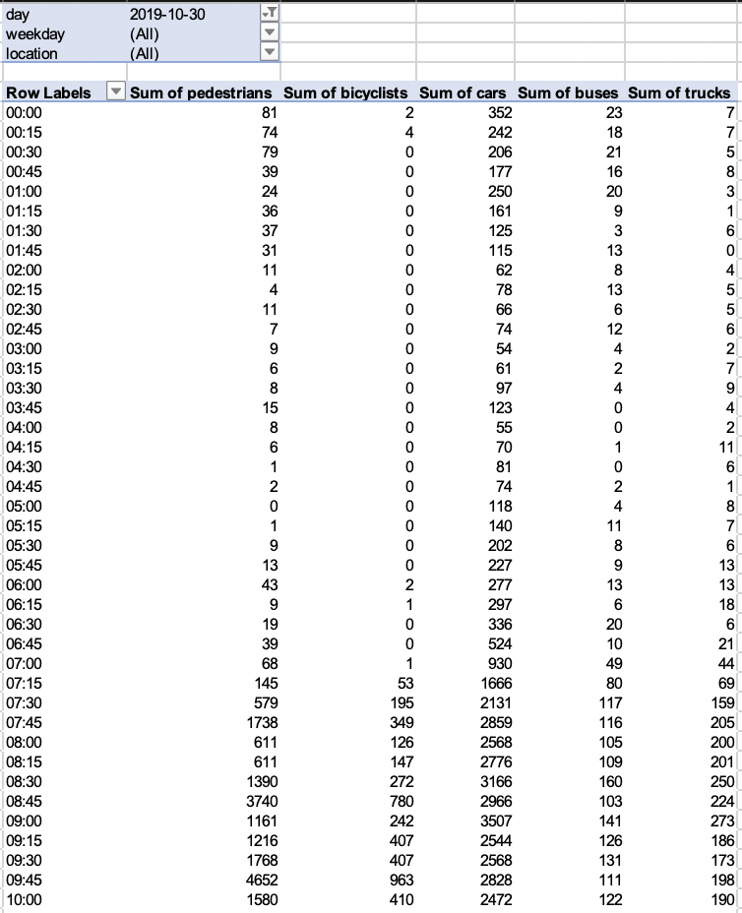
Observe
If you want to search the traffic counts
at a certain time, on a certain date, of a certain mode, at a certain location
What tools you may use?
Excel? Pivot Chart?
Time - consuming!!
Many filters have to be chosen in Excel

Slide 5
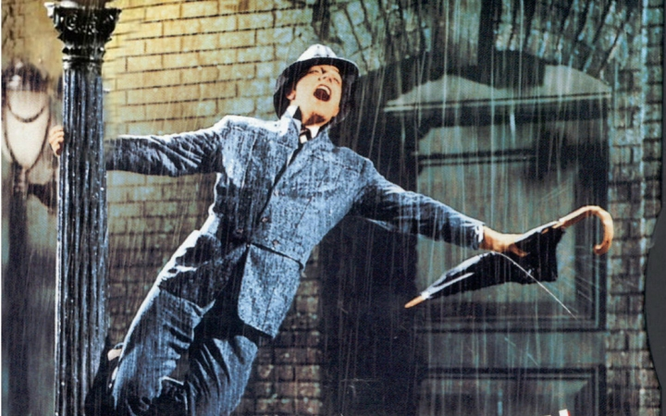


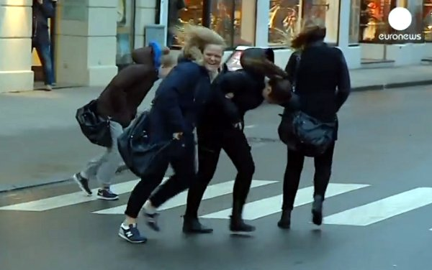
Explorer
For prediction,
you must know what factors may influence on traffic counts
Game Day?
Class Schedule?
Weekday or Weekend?
Big winds? A heavy rain?

Slide 6
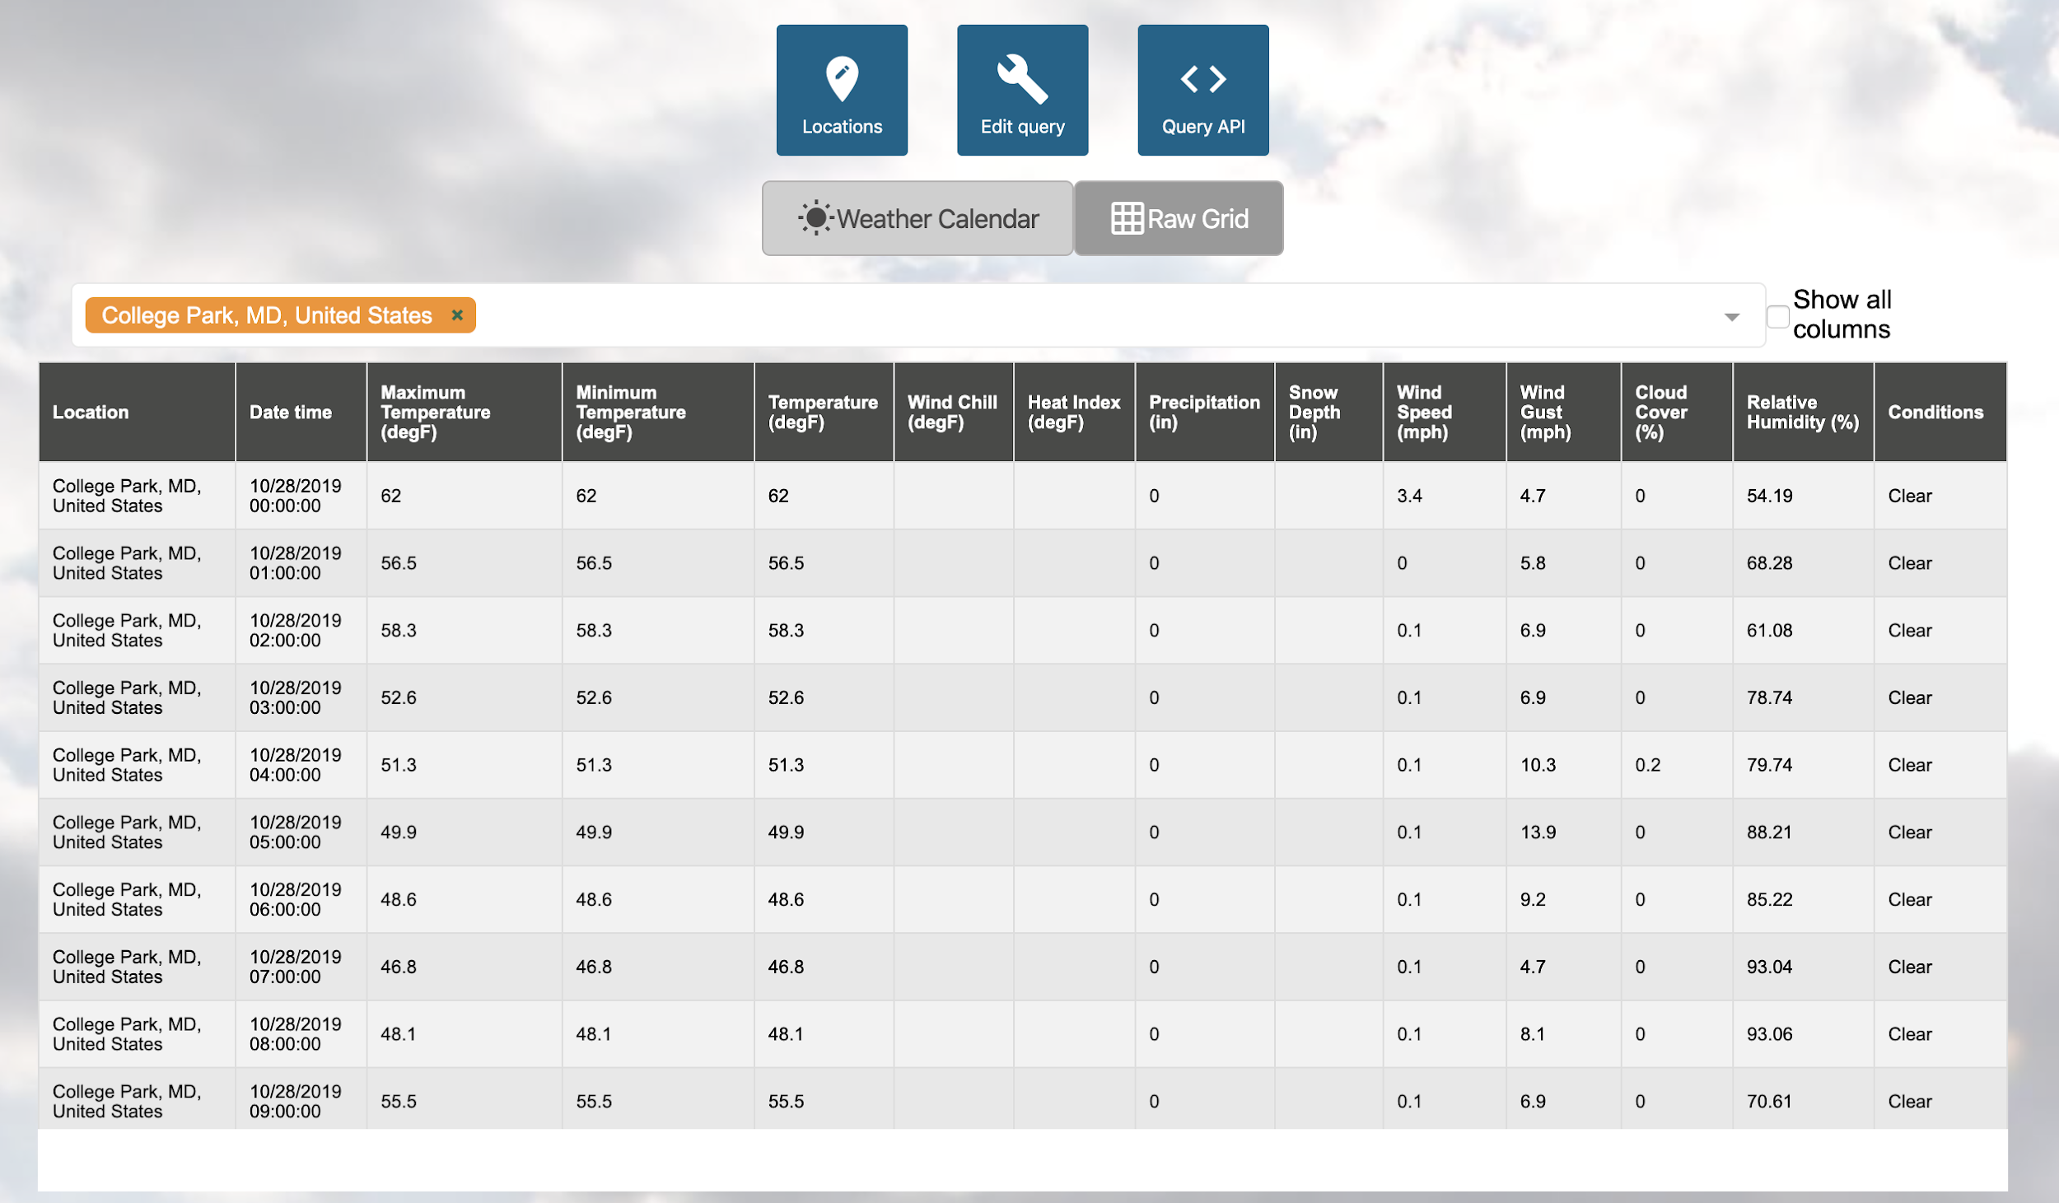
Ok, we got many factors.
Now we need many external data. Find them and merge!
Historical weather records
we need them!

Slide 7
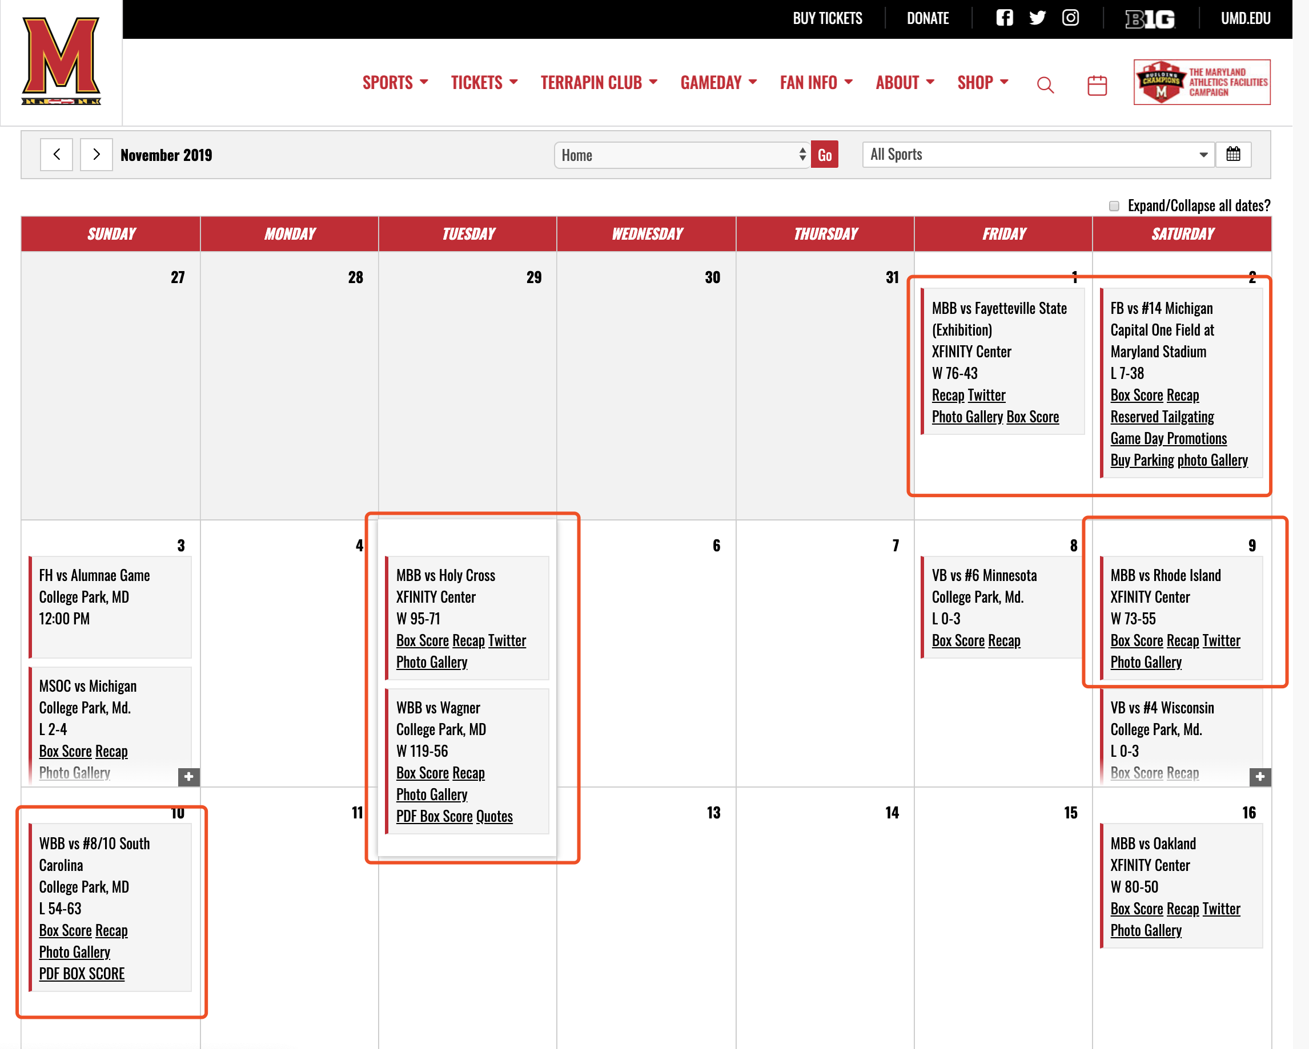
UMD Calendar
Game day!

Slide 8
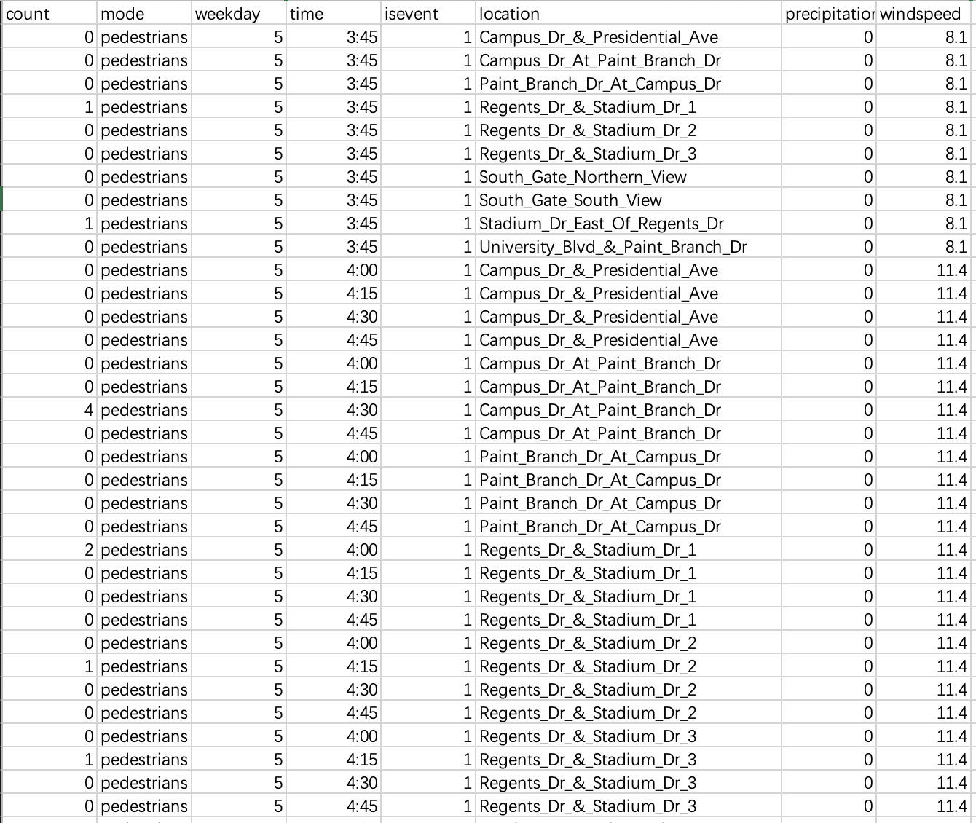
8 Variables
count
mode
weekday
time
isevent
location
precipitation
windspeed
After removing outliers and error data, 63,551 rows
Final Dataset

Slide 9
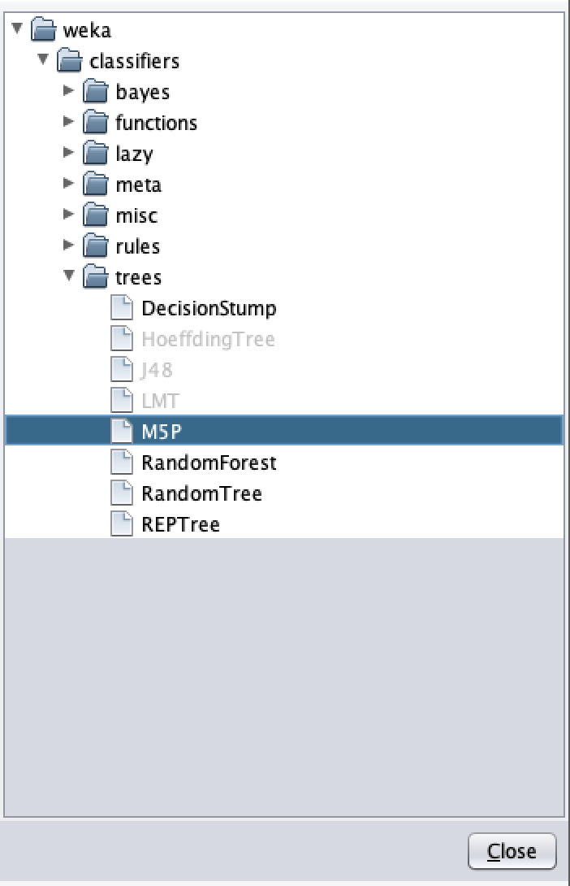
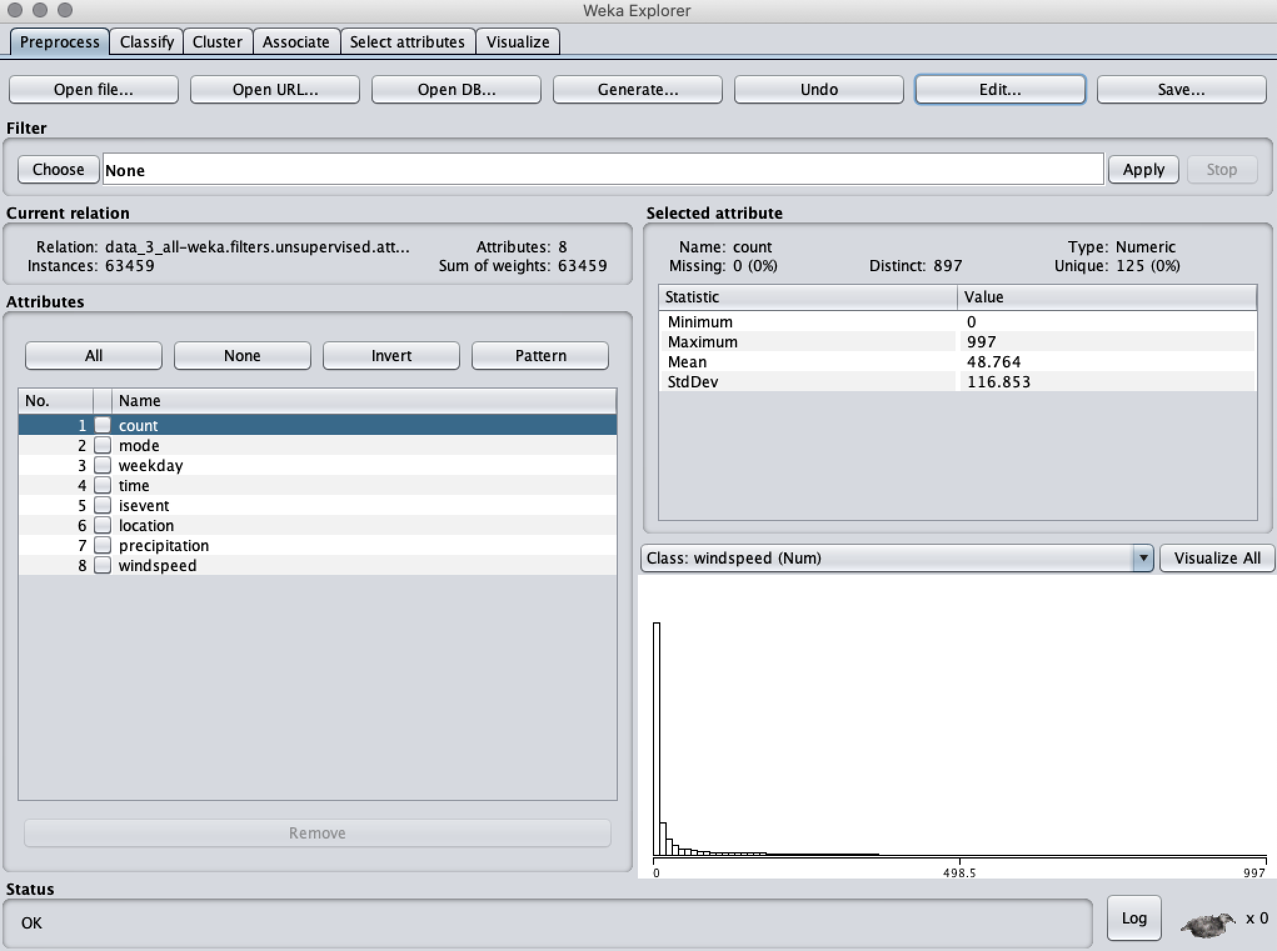

Build a Model
First, find the relationship between factors and counts.
Weka explorer
Choose Model

Slide 10
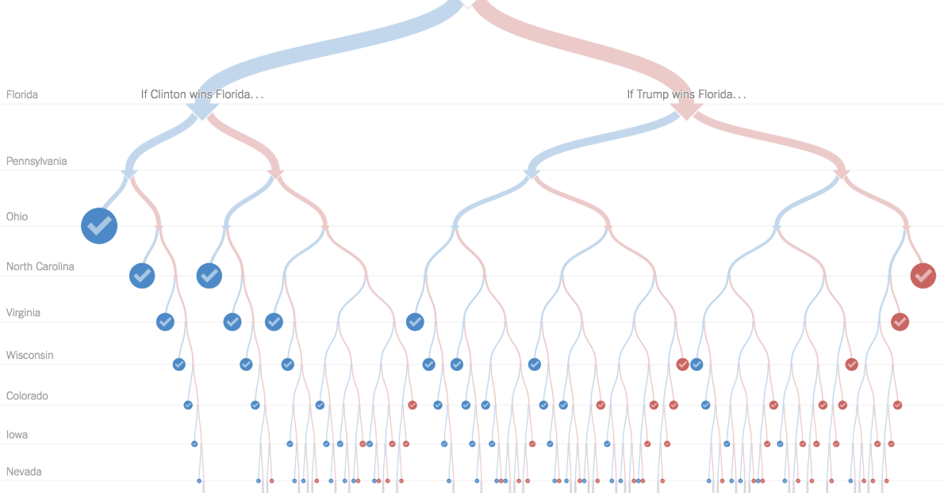
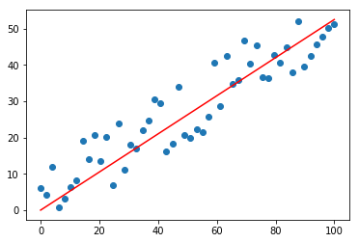

Predictive Model —M5P
Decision Tree
Linear Regression
Input Predictors:
Mode;
Weekday;
Time;
Isevent;
Location;
Precipitation;
Windspeed.
Correlation coefficient 0.9343
Mean absolute error 16.1178
Root mean squared error 41.6572
Relative absolute error 23.7574 %
Root relative squared error 35.6492 %
Outcome:
Count
Looks good!

Slide 11


Create Tools
1.Implement M5P in Python and Javascript
rebuilt in
M5P in weka
rebuilt in

Slide 12
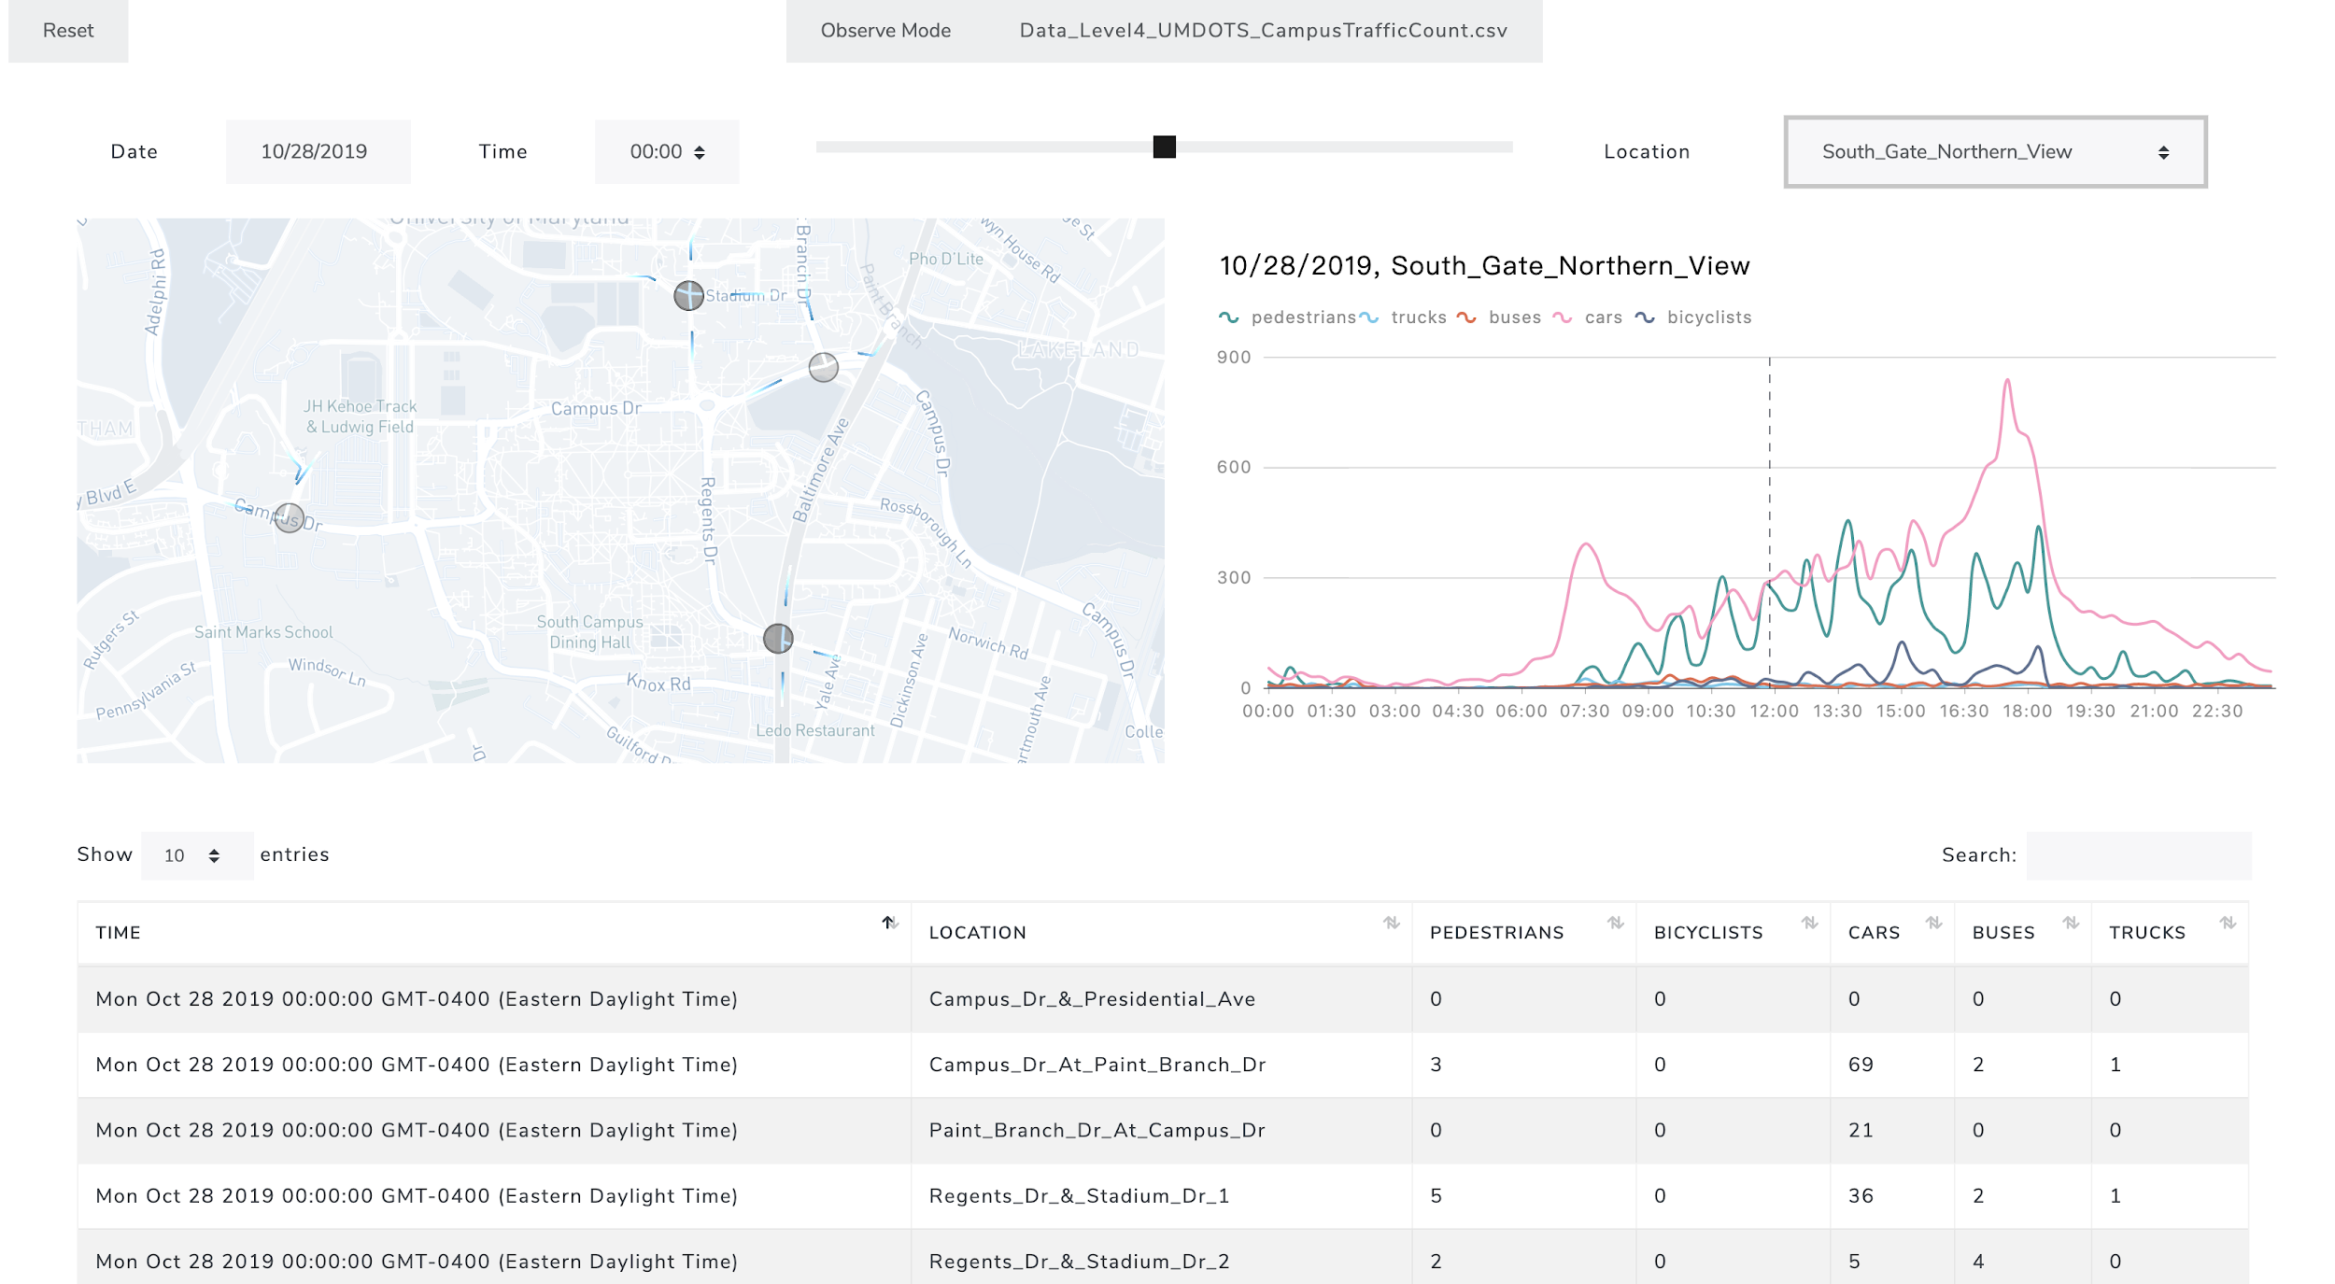
2. Create web-based Visualization Tool
www.GoUMD.com

Slide 13
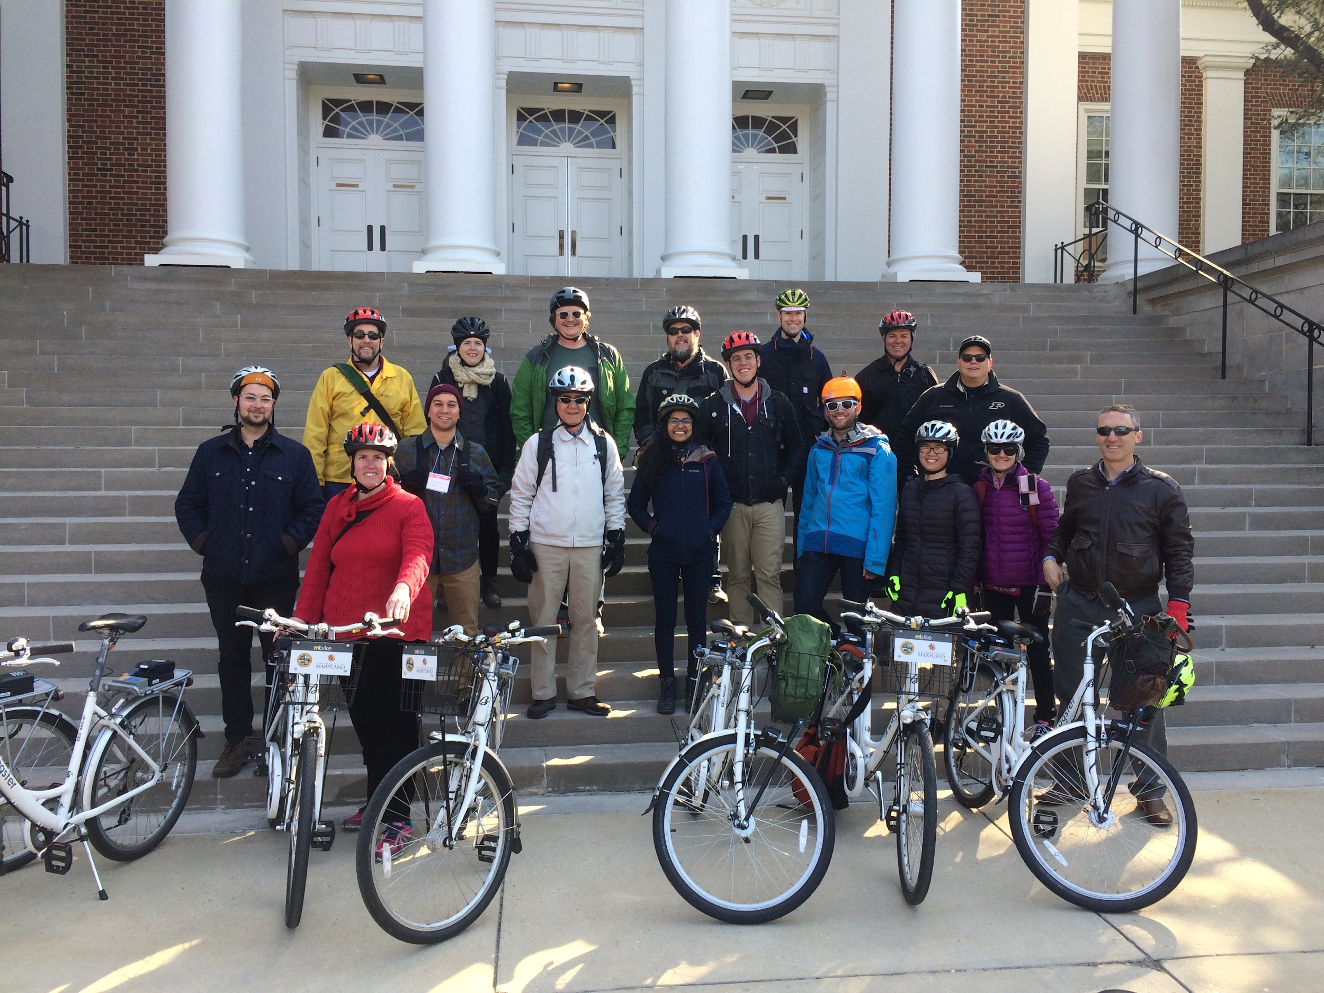
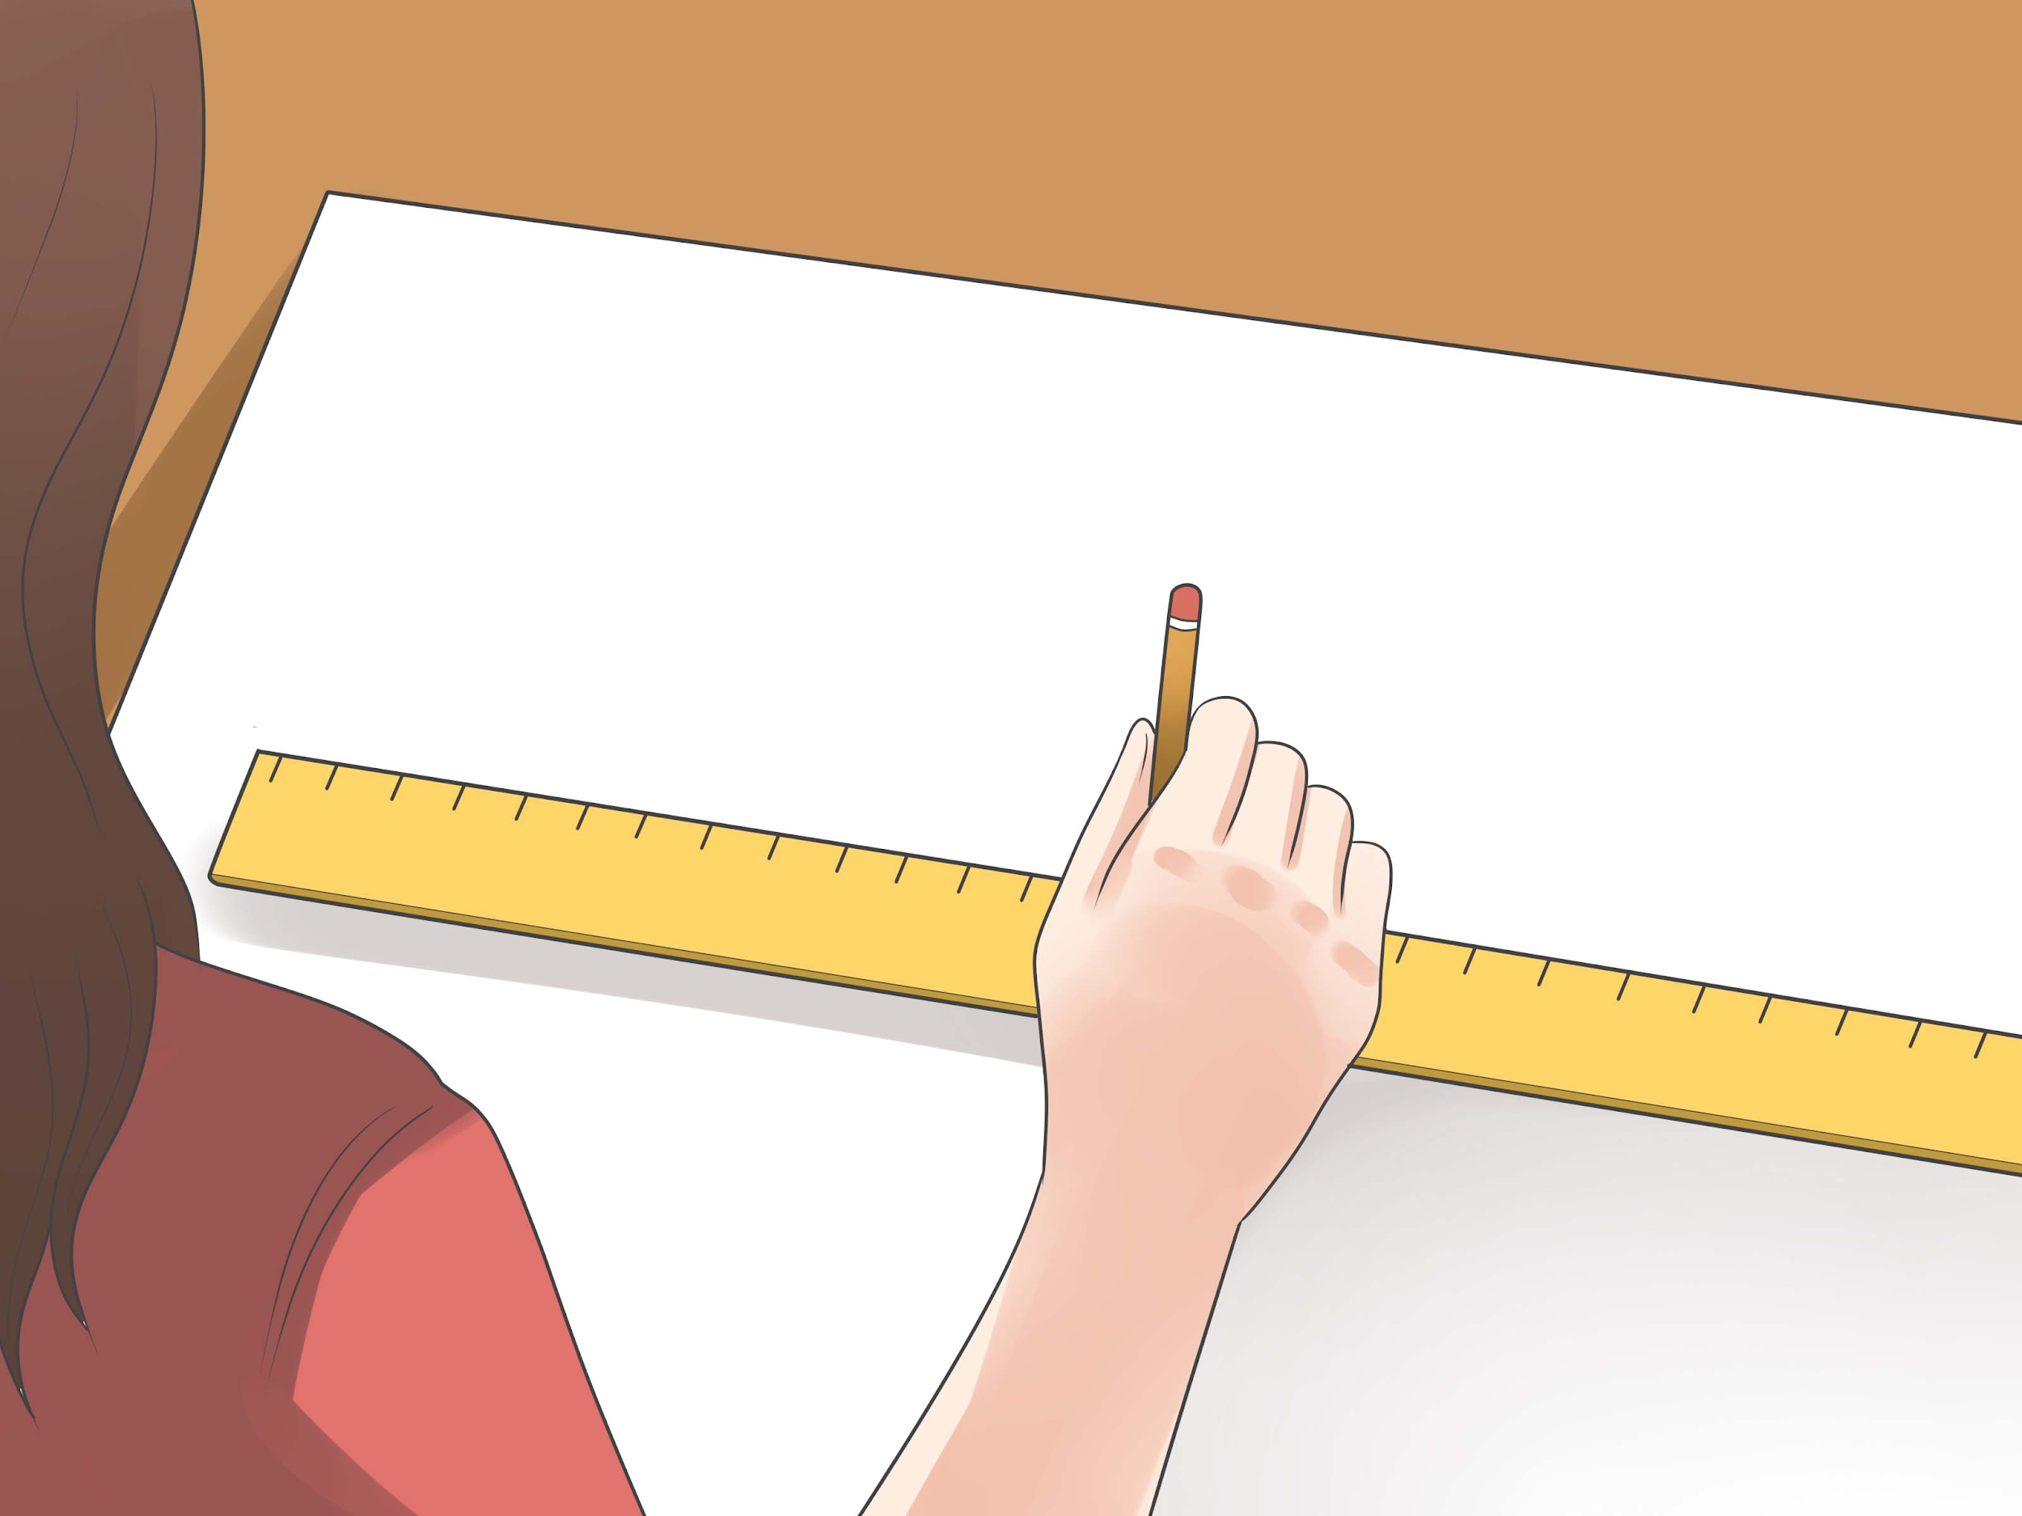
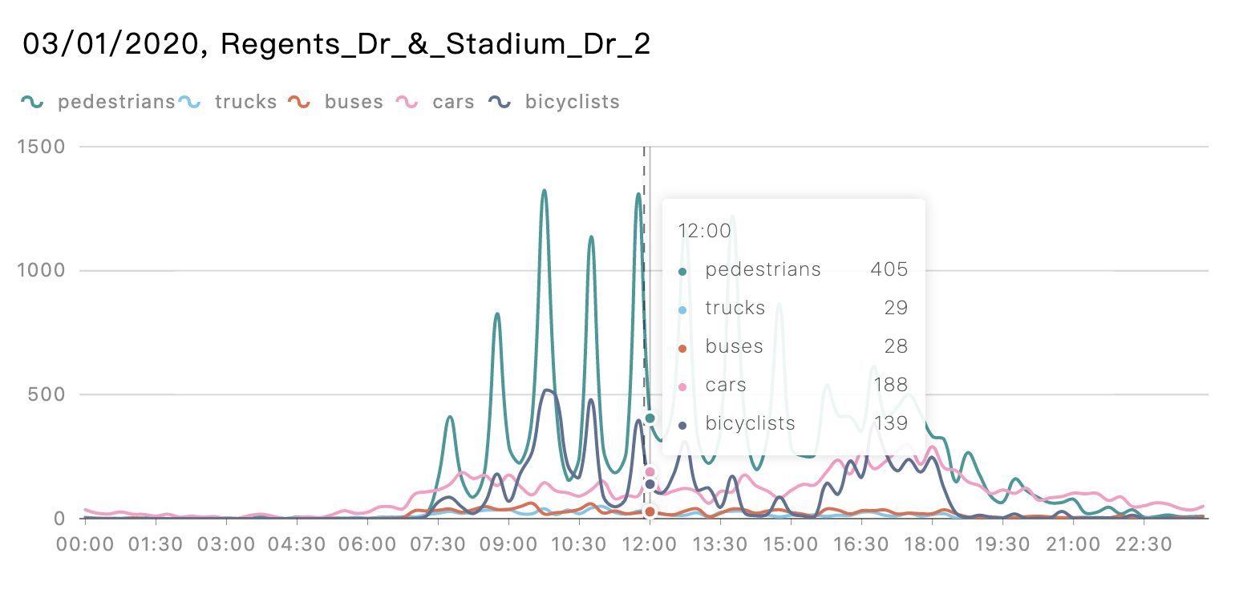
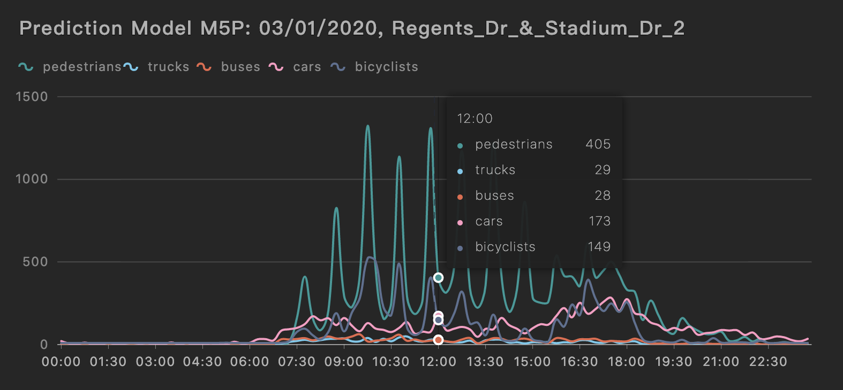
Future use
Did Bicycle event work?
Talk data to me!
More bicyclists, less cars.
It worked!
Sensor Count
Prediction Count

Slide 14
Limitations
Overlapped data
The same instance of mode may be counted multiple times at the same location by different sensors, producing outliers and causing less accurate predictive outcome.
Missing data
only 2-week span, allowing less space for model optimization.
Limited samples
In certain time ranges, some sensors reported 0 counts in a certain period, which is obviously inaccurate.
Notes:
Photo by Ren Ran on Unsplash

Slide 15
Q&A

